Slide 1
iOS Animations
Mobile apps for iPhone & iPad
Telerik Software Academy
http://academy.telerik.com

Slide 2
Table of Contents
Summary
The two visual hierarchies in iOS
Core Animation
UIView animations
UIView transitions
UIKit dynamics
References

Slide 3
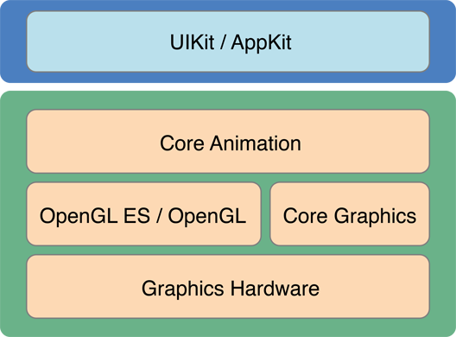
Summary
Core Graphics and Core Animation are the low level tools
UIKit uses Core Animation
There are two UI hierarchies in iOS
UIView and CALayer

Slide 4
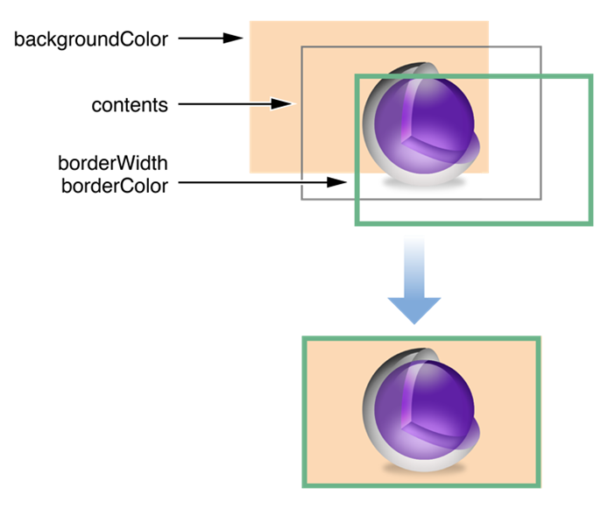
Core Animation: The CLLayer Class
It has position, size and transformation matrix
It has background, content, and border
There is no concept for margin or padding, nothing like a box model
Every layer can have sub layers
The content of the layer is cached

Slide 5
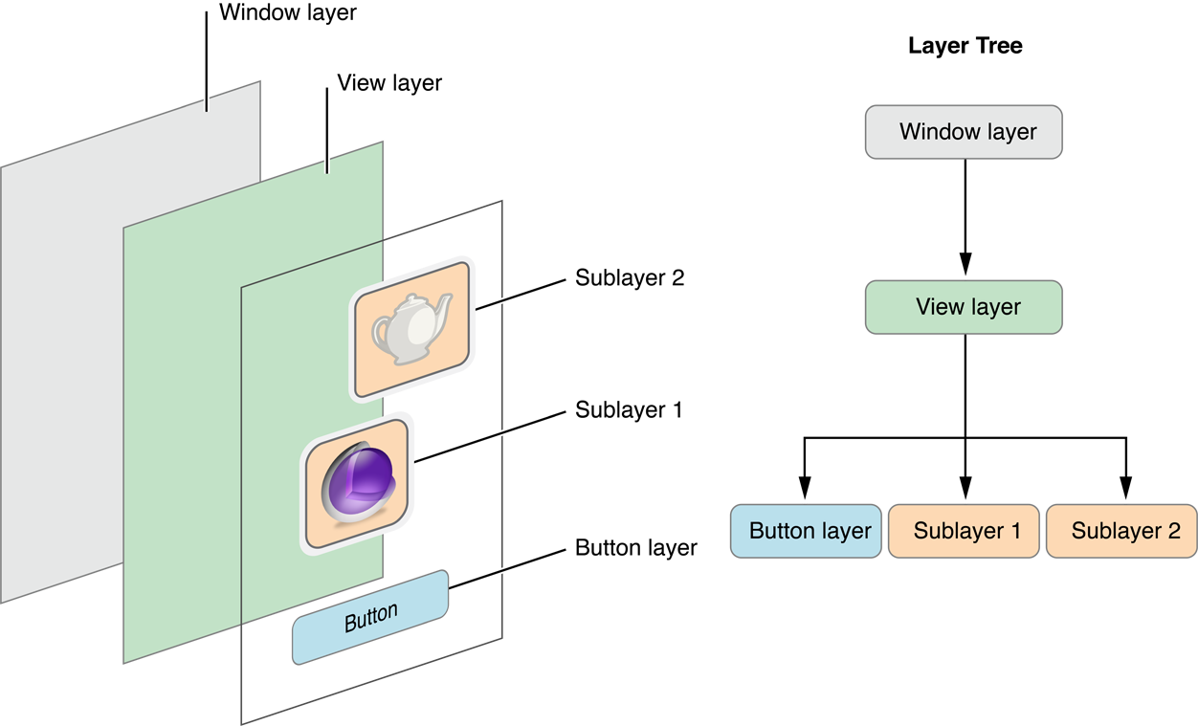
Core Animation: The UIView Class
It can handle user events
It is backed by a layer
Can contain one or more sub views

Slide 6
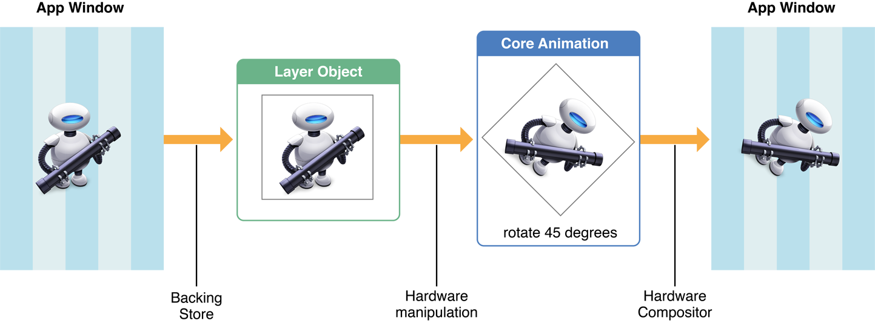
How Core Animation Works?
Core Animation animates layers
There are three sets of layer objects
Model, presentation and render
Core Animation creates temporary layers for every animation state
Core Animation tries to cache everything in bitmaps

Slide 7
Core Animation: Sample
layer.backgroundColor = [UIColor greenColor];
layer.opacity = 0.5;
CABasicAnimation *a =
[CABasicAnimation animationWithKeyPath:@"position"];
a.fromValue = [NSValue valueWithCGPoint:(CGPoint){ 100, 100 }];
a.toValue = [NSValue valueWithCGPoint:(CGPoint){ 100, 400}];
a.duration = 1;
a.timingFunction = [CAMediaTimingFunction
functionWithName:
kCAMediaTimingFunctionEaseOut];
[layer addAnimation:a forKey:nil];
CAKeyframeAnimation *a =
[CAKeyframeAnimation animationWithKeyPath:@"position.x"];
a.values = @[ @100, @170, @200 ];
a.keyTimes = @[ @0, @0.5, @1 ];
a.duration = 1;
[layer addAnimation:a forKey:nil];

Slide 8
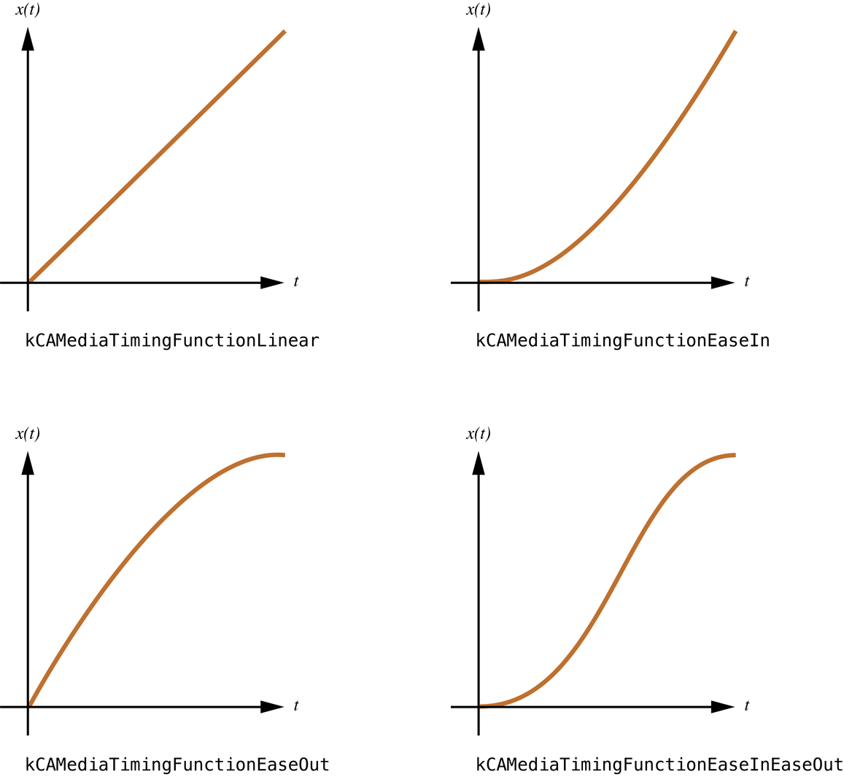
Timing Functions in Core Animation

Slide 9
Core Animation: Timing Functions
Live Demo

Slide 10
Sequential Animations in Core Animation
Implement the animation delegate and handle one of its methods:
@interface NSObject (CAAnimationDelegate)
- (void)animationDidStart:(CAAnimation *)anim;
- (void)animationDidStop:(CAAnimation *)anim finished:(BOOL)flag;
@end
Use keyframe animation and customize its key times:
CAKeyframeAnimation *a2 =
[CAKeyframeAnimation animationWithKeyPath:@"opacity"];
a2.values = @[ @1., @1., @0.3 ];
a2.keyTimes = @[ @0, @0.5, @1 ];
a2.duration = 2;
[layer addAnimation:a2 forKey:nil];

Slide 11
Core Animation: Sequential Animations
Live Demo

Slide 12
Custom Animatable Properties
Override the needsDisplayForKey: method:
+ (BOOL)needsDisplayForKey:(NSString *)key {
if([key isEqualToString:@"seriesRenderStates"])
return YES;
return [super needsDisplayForKey:key];
}
Override the initWithLayer method and copy the property value:
- (id)initWithLayer:(id)layer {
self = [super initWithLayer:layer];
if (self) {
MyLayer *copyFrom = layer;
_myProperty = copyFrom.myProperty;
}
return self;
}

Slide 13
Stopping the Animations
Call one of the following methods: removeAllAnimations or removeAnimationForKey:
layer.position = CGPointMake(200, 100);
[layer removeAllAnimations];
Override the actionForKey: method:
- (id<CAAction>)actionForKey:(NSString *)event{
return nil;
}
Set the speed property of the layer to a high value:
layer.speed = 10000;

Slide 14
UIKit Animations
A limited number of animatable properties
Custom animatable properties cannot be created
All animations are disabled by default
Animations are enabled only when using special constructs
Two ways to add animations:
Animation blocks
Begin/Commit blocks (old style)
[UIView animateWithDuration:1.0 animations:^{
firstView.alpha = 0.0;
secondView.alpha = 1.0;
}];

Slide 15
UIKit Animations: Animation Blocks
[UIView animateWithDuration:1.0
delay: 0.0
options: UIViewAnimationOptionCurveEaseIn
animations:^{
thirdView.alpha = 0.0;
}
completion:^(BOOL finished){
// Wait one second and then fade in the view
[UIView animateWithDuration:1.0
delay: 1.0
options:UIViewAnimationOptionCurveEaseOut
animations:^{
thirdView.alpha = 1.0;
}
completion:nil];
}];

Slide 16
UIKit Animations: The old style
[UIView beginAnimations:@"ToggleViews" context:nil];
[UIView setAnimationDuration:1.0];
// Make the animatable changes.
firstView.alpha = 0.0;
secondView.alpha = 1.0;
// Commit the changes and perform the animation.
[UIView commitAnimations];

Slide 17
UIView Transitions
Those are transitions between views when pushing a new view controller
Introduced in iOS 7
Support interactivity
Relatively simple, you have to implement two protocols and 4-5 methods:
UIViewControllerTransitioningDelegate
UIViewControllerAnimatedTransitioning
UIViewControllerInteractiveTransitioning

Slide 18
UIKit Dynamics
Built-in physics engine
Adds motion effects directly in all views
Supports custom objects that implement the UIDynamicItem protocol
The UIDynamicAnimator class animates everything
There are behaviors for gravity, forces, elasticity, collisions, and snap points
animator = [[UIDynamicAnimator alloc] initWithReferenceView:self.view];
[animator addBehavior:[[UIGravityBehavior alloc] initWithItems:@[view]]];
UIPushBehavior *push = [[UIPushBehavior alloc] initWithItems:@[view]
mode:UIPushBehaviorModeInstantaneous];
push.pushDirection = CGVectorMake(50., 50.);
[animator addBehavior:push];

Slide 19
Core Animations: UIKit Dynamics
Live Demo

Slide 20
iOS Animations
http://academy.telerik.com

